Slide 1
Interpolating Orientation

Slide 2
Orientation Interpolation
Quaternions can be interpolated to produce in-between orientations:
2 problems analogous to issues when interpolating positions:
How to take equi-distant steps along orientation path?
How to pass through orientations smoothly (1st order continuous)

Slide 3
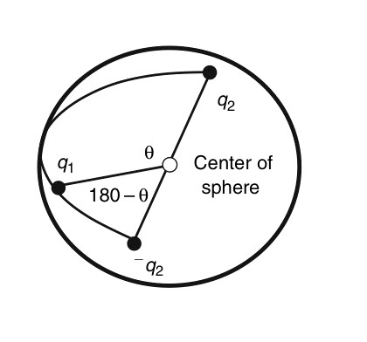
Unit Quaternion Representation
For Interpolation between q1 and q2, compute cosine between q1 and q2 and between q1 and –q2; choose smallest angle

Slide 4
Interpolating quaternions
Unit quaternions form set of points on 4D sphere
Linearly interpolating unit quaternions: not equally spaced

Slide 5
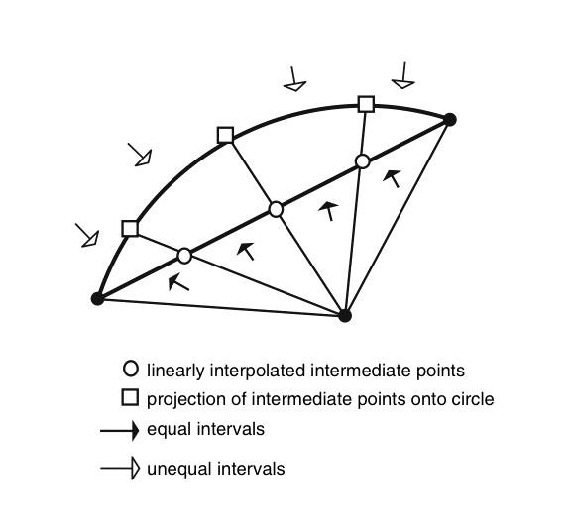
Interpolating quaternions in great arc – equal spacing

Slide 6
Interpolating quaternions with equal spacing
where
‘slerp’, sphereical linear interpolation is a function of
the beginning quaternion orientation, q1
the ending quaternion orientation, q2
the interpolant, u

Slide 7
Smooth Orientation Interpolation
Use quaternions
Interpolate along great arc (in 4-space) using cubic Bezier on sphere
1. Select representation to use
2. Construct interior control points for cubic Bezier
3. use De Casteljau construction of cubic Bezier

Slide 8
Smooth Quaternion Interpolation
Similar to first order continuity desires with positional interpolation
How to smoothly interpolate through orientations q₁, q₂, q₃,…q_{n}
Bezier interpolation – geometric construction

Slide 9
Bezier Interpolation

Slide 10
Bezier Interpolation - construct interior control points
t_{n}
b_{n}
q_{n}
q_{n}
q_{n-1}
a_{n}
q_{n+2}
q_{n-1}
a_{n}
q_{n+2}
q_{n+1}
q_{n+1}
q_{n}
q_{n-1}
a_{n}
q_{n+2}
q_{n+1}
a₀
b_{n+1}
a_{n+1}
q₁
q₂
t_{n+1}
q₀

Slide 11
Quaternion Operators
q₂
q_{b}
bisect(q₁, q₂)
Similar to forming a vector between 2 points, form the rotation between 2 orientations
q₁
q₂
double(q₁, q₂)
Given 2 orientations, form result of applying rotation between the two to 2nd orientation
q₁
q_{d}

Slide 12
Quaternion Operators
Given p and q, form r
‘Double’ where q’ is the mid-orientation between p and the yet-to-be-determined r
p
q
If p and q are unit quaternions,
Then q’ = cos(θ)q and cos(θ)=
q’
θ
r
θ
Given p and r, form q
Bisect 2 orientations:
if p and r are unit length

Slide 13
Bezier Interpolation
Need quaternion-friendly operators to form interior control points

Slide 14

Bezier Interpolation – construct interior control points
t_{n}
$$a_{n}=bisect(double\left(q_{n−1}, q_{n}\right),q_{n+1})$$
q_{n}
q_{n-1}
a_{n}
q_{n+2}
b_{n}
q_{n+1}
q_{n}
q_{n-1}
a_{n}
q_{n+2}
$$b_{n}=double(a_{n},q_{n})$$
q_{n+1}
q_{n}
q_{n-1}
a_{n}
q_{n+2}
Bezier segment:
q_{n,} a_{n,} b_{n+1,} q_{n+1}
q_{n+1}
b_{n+1}
a_{n+1}
t_{n+1}

Slide 15
Bezier construction using quaternion operators
Need quaternion-friendly operations to interpolate cubic Bezier curve using ‘quaternion’ points
de Casteljau geometric construction algorithm

Slide 16
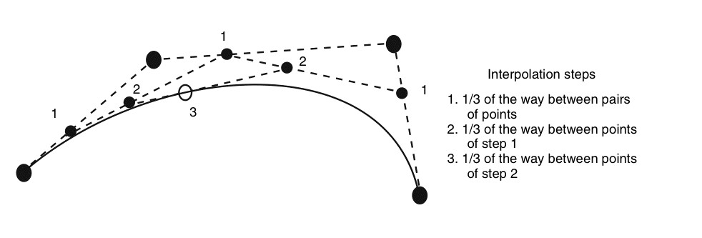
Bezier construction using quaternion operators
For p(1/3)
t₁=slerp(q_{n,} a_{n},1/3)
t₂=slerp(a_{n,} b_{n+1},1/3)
t₃=slerp(b_{n+1,} q_{n+1},1/3)
t₁₂=slerp(t_{1,} t₂,1/3)
t₂₃=slerp(t_{12,} t₂₃,1/3)
q=slerp(t_{12,} t₂₃,1/3)

